Slide 1

TWIST ‘n’ TREATS
Banupriya Rajasekeran

Slide 2
OBJECTIVE
Twist ‘n’ Treats is a donut shop automation project that aims to create a platform where store owners can efficiently manage their product display.
It also provides a user-friendly interface for customers to purchase donuts, cakes, cupcakes, and drinks with ease.
Features:
1.Product Management:
Add, edit, and delete different types of donuts.
Set prices, descriptions, and images for each donut.
Track available inventory for each type of donut.
2.Order Processing:
Allow customers to place orders online.
Provide a shopping cart for customers to review and modify their orders.
Customers can place order online and can see their order summary
3.User Authentication:
Implement a secure login system for administrators and staff.
Define user roles with different levels of access (e.g., admin, cashier).

Slide 3
Technology Used
Java | SpringBoot
Spring MVC | Spring Security
Spring Data JPA | Hibernate
Lombok | MySQL
HTML5 | CSS
Bootstrap | Javascript
Junit | Git/Github

Slide 4
PRODUCT OWNER(ADMIN)
The admin possesses unique privileges, including:
Adding new products and categories.
Viewing the existing product line.
Modifying product parameters such as price.
Deleting products and categories.

Slide 5
CUSTOMER
Upon entering the system with user credentials, the user can perform the following actions:
View products available for purchase.
Add items to the cart.
Edit items within the cart.
Delete items from the cart.
View the order summary.

Slide 6
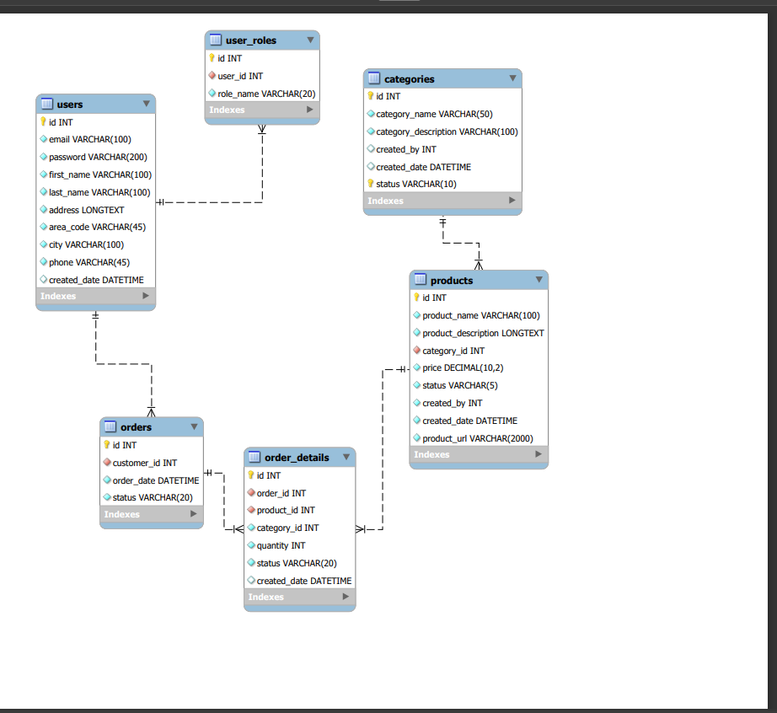
ENTITY RELATIONSHIP DIGRAM

Slide 7
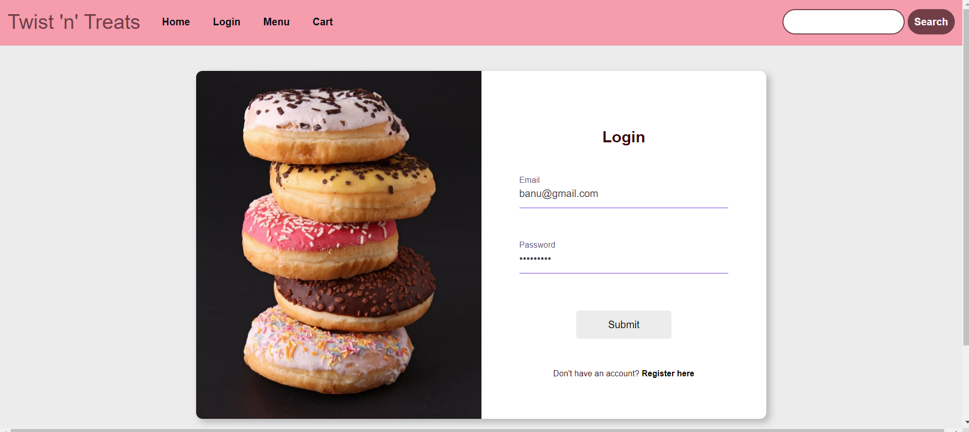
LOGIN PAGE - ADMIN

Slide 8
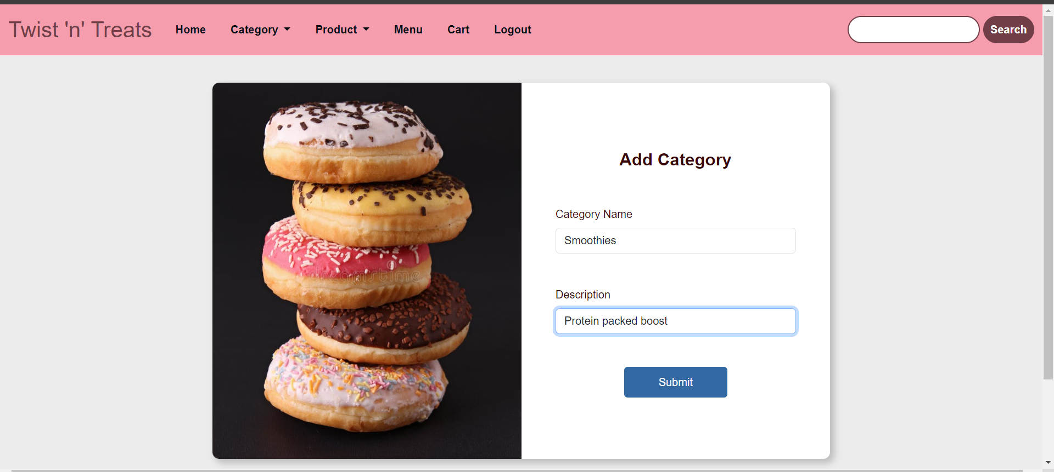
ADD CATEGORY

Slide 9
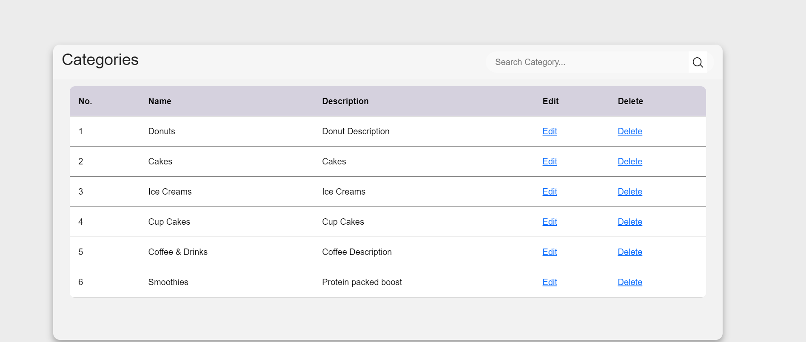
SEARCH CATEGORY

Slide 10
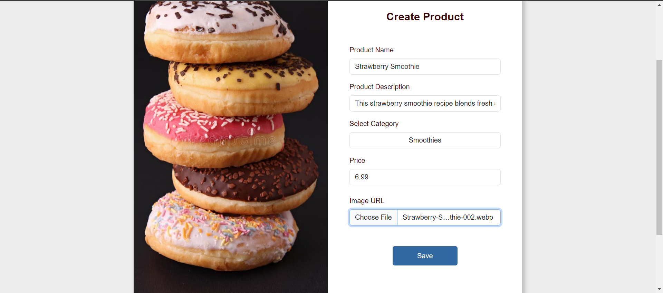
ADD PRODUCT

Slide 11
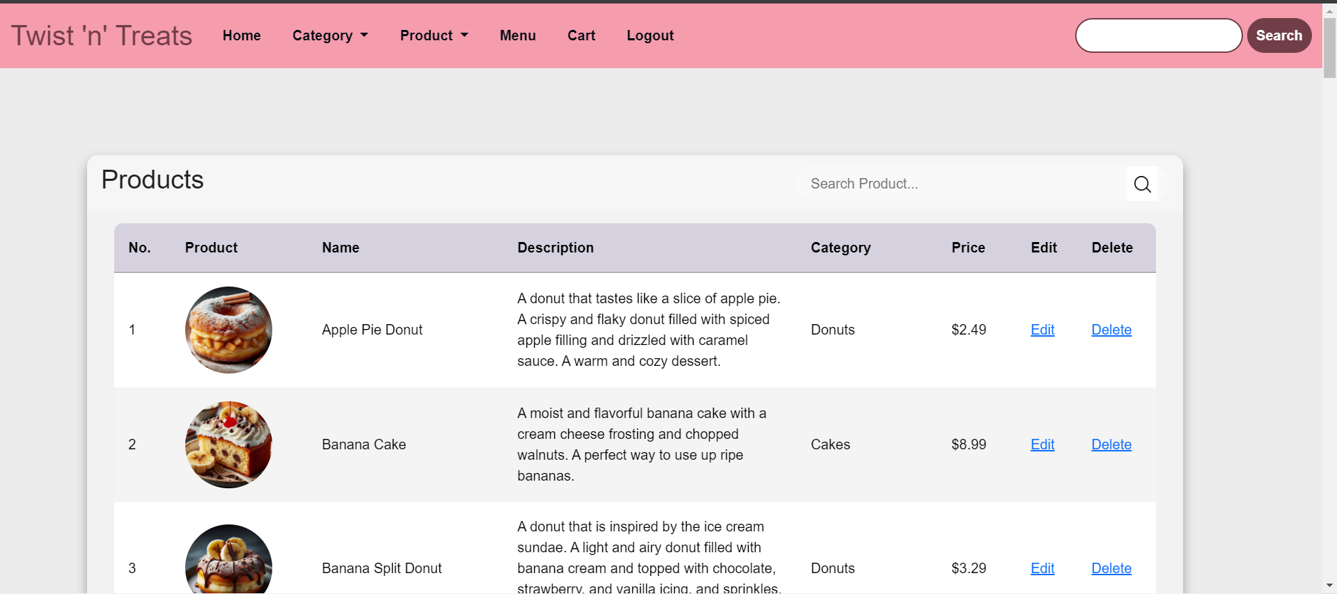
SEARCH PRODUCT

Slide 12
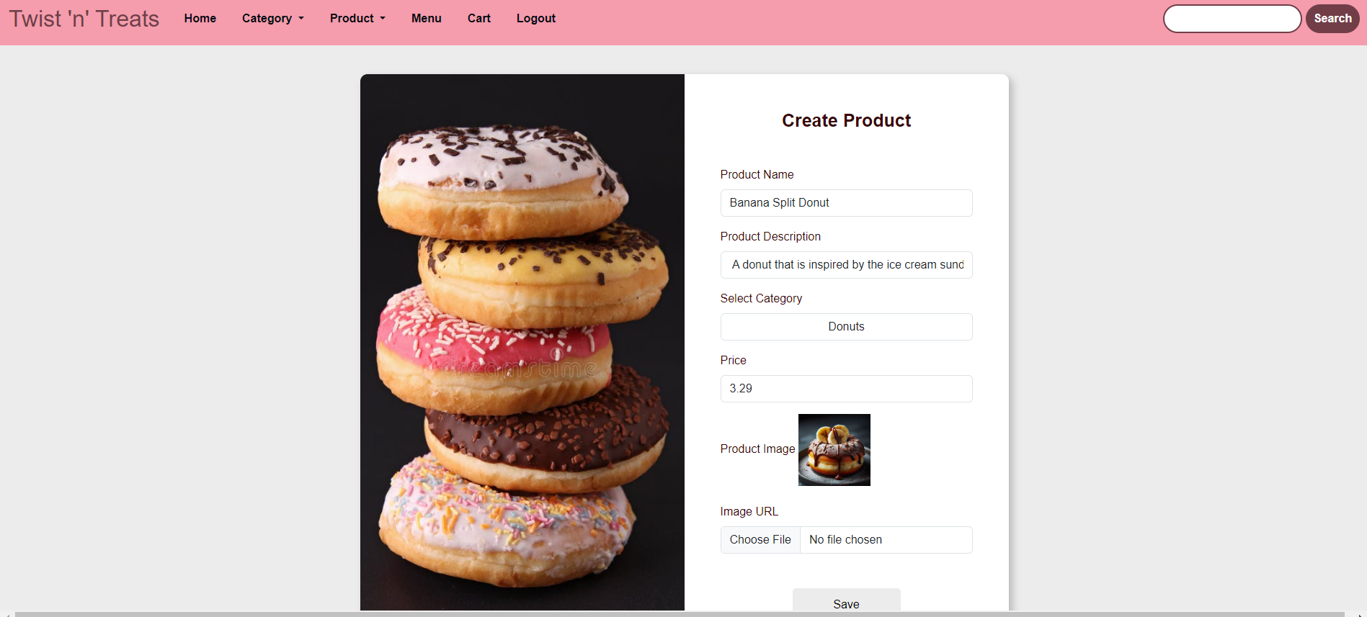
EDIT PRODUCT

Slide 13
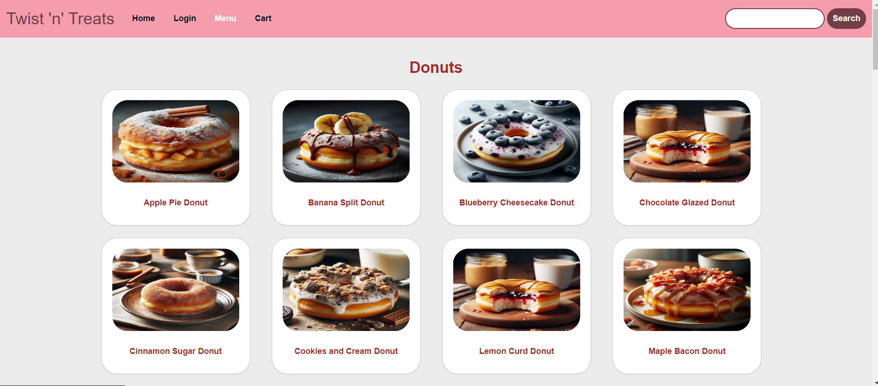
MENU

Slide 14
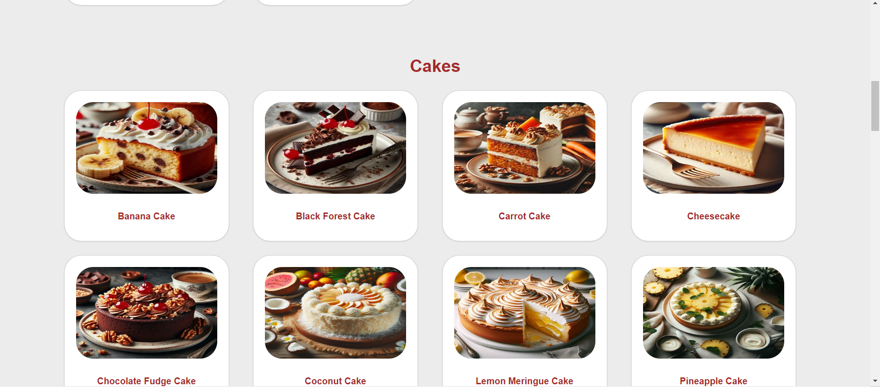
MENU (CONTINUED)

Slide 15
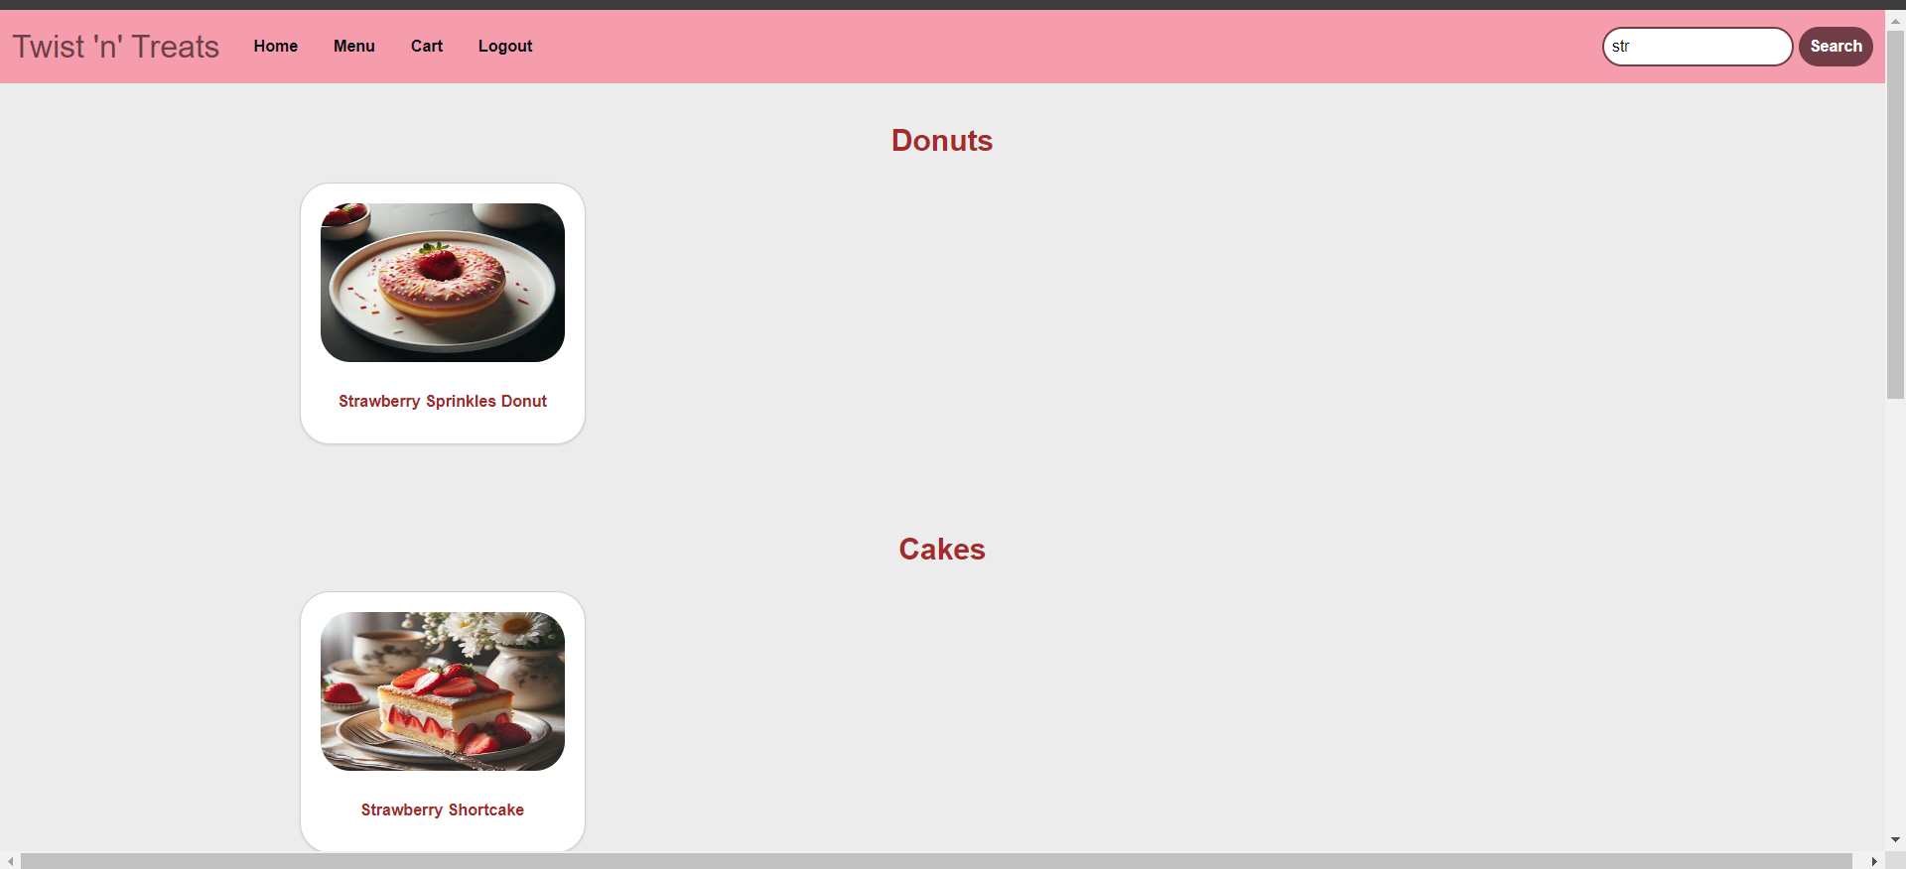
SEARCH BOX

Slide 16
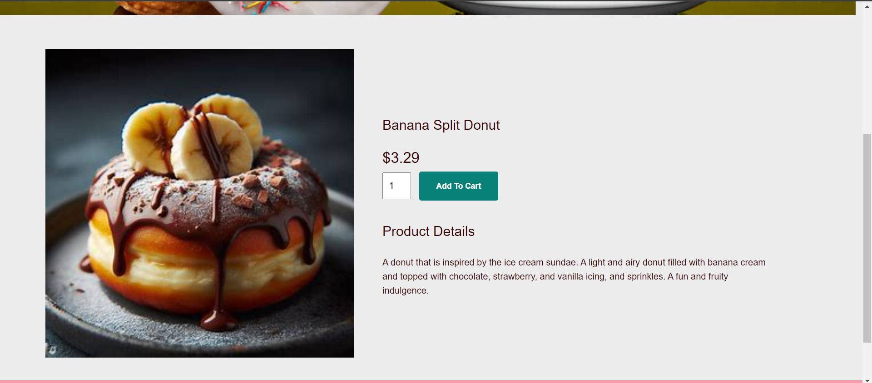
PRODUCT DETAILS – ADD TO CART

Slide 17
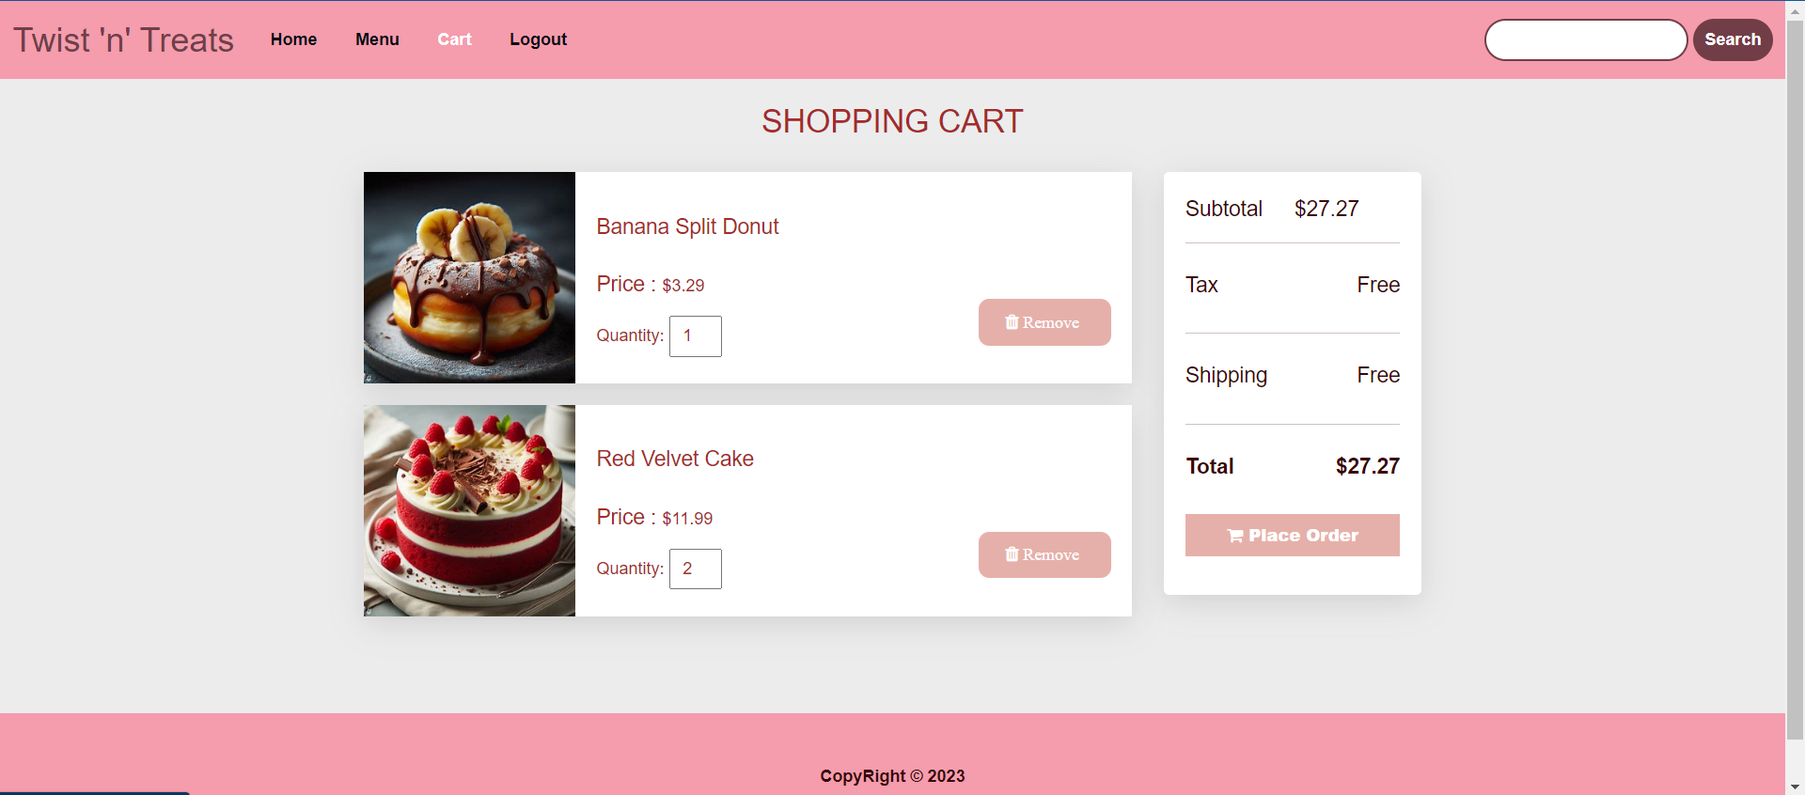
CART

Slide 18
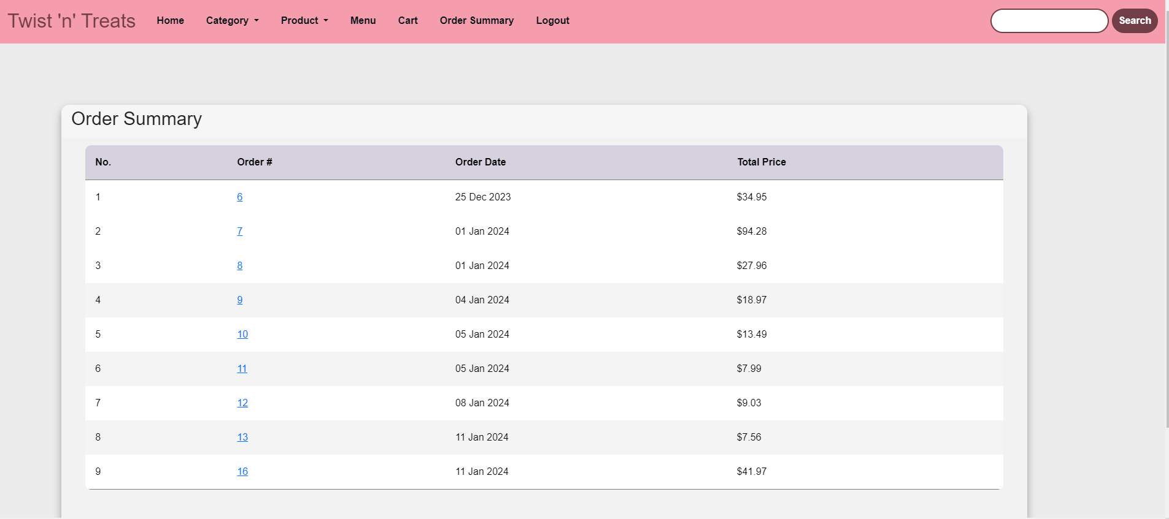
ORDER SUMMARY

Slide 19
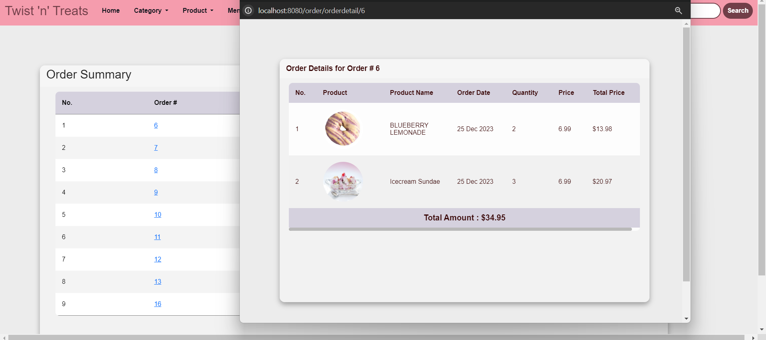
ORDER DETAILS

Slide 20
THE END
THANK YOU

